Slide 1
2017 California Child Care Portfolio Briefing
Wednesday, February 7, 2018
Notes:
Welcome everyone!
My name is Rowena Kamo, Research Director, CA Child Care Resource & Referral Network
Excited to have you all here for a briefing of our 11th Edition of the California Child Care Portfolio.
Sharing with you major findings from our most recent report.

Slide 2
2017 Portfolio
“The Portfolio provides a bird’s eye view of child care needs throughout CA and a powerful tool for addressing them.” – Patty Siegel excerpt from 1997 Child Care Portfolio
Notes:
The Child Care Portfolio is unique in its kind.
In it’s 11th edition, it is the only county-by-county and statewide report documenting the licensed child care supply and request for care,
allowing us to have a picture of how our child care market is growing and shrinking – like we see today.

Slide 3
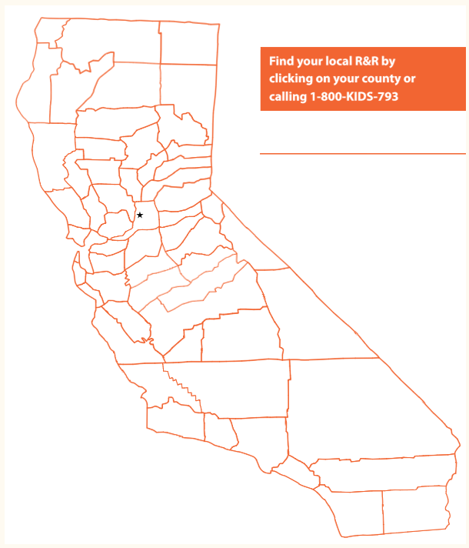
Child Care Resource & Referral
Local child care resource & referral programs in every county across the state
Notes:
Our data comes directly from those on the ground, our local child care resource and referral programs
Referral Counselors and staff, people that you have met with today are touchpoints in the community, connecting parents and providers and offering free resources to all parents
R&Rs have the most up to date information in the state that includes information on small FCCs – exclusive to R&Rs.

Slide 4
Major Findings
Notes:
The data in the following slides are mostly in comparison to data that was collected in 2014 – the last time we released the Portfolio. In the future, we hope to report changes year after year.

Slide 5
Shortage of Care for Working Families
Top 3 Reasons Families Seek Child Care
Employment | 80%
In School or Training | 12%
Seeking Employment | 8%
Licensed Child Care is only available for 23% of children with working parents
Notes:
What does this mean for working families?
In 2016 California’s unemployment rate dropped to 5.4%, which means people are heading back to work. 80% of the parents who called their R&R looked for care because they are working – almost all parents were looking for full-time care.
For parents that means having child care that meets not only their specific work needs, but also the unique needs of the child and also the values of the family
We estimate that there are over 4.2 million children with working parents and yet, licensed child care is only available for less than a quarter of children with working parents.
So what’s does our child care supply look like?

Slide 6
Licensed Child Care Slots
708,377
283,422
Notes:
Statewide, we saw a decrease in the number of child care supply of about -4%.
Notice that center-based care has remained fairly stable over the years, though in this Portfolio there was a slight decrease of 2%
-possible reasons we’ve heard from the field:
-low reimbursement rates from the state have caused contracted centers to close
-impact of transitional kindergarten
As we’ve seen in previous years, the continual decline of family child care home providers. Statewide the change is about 10%.

Slide 7
Supply Change by Region
Statewide:
Center: -2%
Homes: -9
North
Center: 3%
Homes: -14%
Bay Area
Center: 2%
Homes: -6%
Central
Center: 1%
Homes: -8%
South
Center: -5%
Homes: -11%
Notes:
There are regional differences in the child care supply.
The past few years have been particularly difficult with natural disasters in the northern part of our state
Unable to afford child care costs, utilizing free programs

Slide 8
Age Breakdown of Licensed Supply
14%
6+ yrs
29%
FCC
52%
2-5 yrs
6%
Under
2 yrs
Notes:
There are almost 1 million infants and toddlers in CA and yet it is one of the most difficult types of care to find. Only 6% center-based slots are dedicated for children under 2 years. Family child care home providers are more likely to care for young children, however their capacity to care for infants is limited to the allowed ratios for FCC providers

Slide 9
Licensed Family Child Care Home Slots 1996-2017
-26%
Notes:
Family Child Care Homes are small business Between 2008 and 2017, the height of the CA’s child care growth California has seen family child care businesses shrink by 26%.
-people lost their homes, low wages, retiring, not as many people entering the field as there are leaving
Why is this important?
-FCC’s are more likely to care for infants and toddlers, have more affordable care options, have smaller group sizes, also provide more flexible schedules, such as both full-time and part-time care (80%) and non-traditional hours of care (41%)
-We estimate that the family child care home providers have the capacity to serve over 65,000 infants.

Slide 10
Counties with Largest FCCH Decrease

Slide 11
Family budgets

Slide 12
What does this mean for California families?

Slide 13
Impacts on California’s families
California is in dire need to build its child care supply
Focusing efforts on family child care home businesses is important
Affordability is critical for economic stability
Notes:
-This is important in ensuring that both private paying families and families utilizing subsidized child care have options to meet their family’s needs. Without an ample supply of care, working parents will have limited options
-Infants and toddlers are most likely to be cared for in family child care homes.

Slide 14
Thank you!
Please visit our website to view and download your county’s child care information:
www.rrnetwork.org/2017_portfolio

